Slide 1
RAIN FORCASTING
Presented by : CH.ROHIT

Slide 2
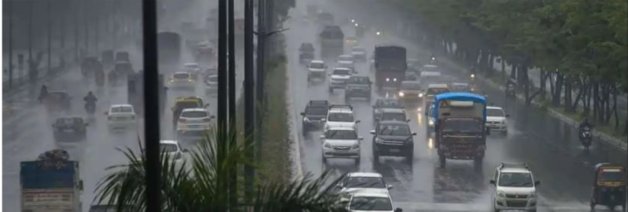
MUMBAI RAIN FORECASTING
Rainfall forecasting is the process of predicting the amount, timing, and location of future rainfall events. Accurate rainfall predictions are crucial forwater resource management, agriculture, and disaster preparedness.

Slide 3
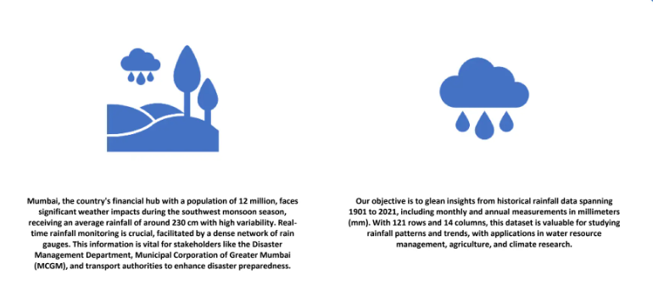
INTRODUCTION

Slide 4
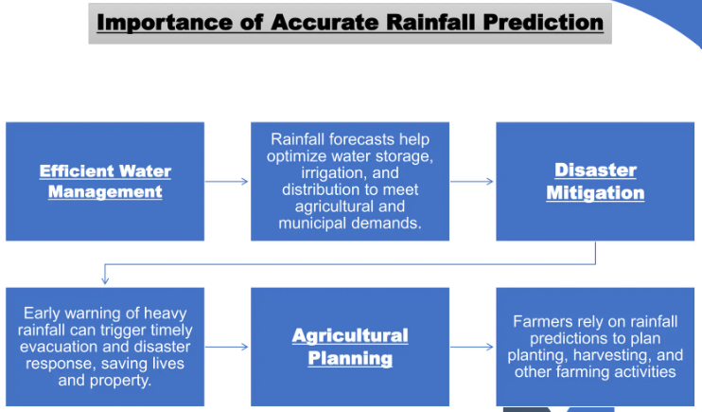

Slide 5
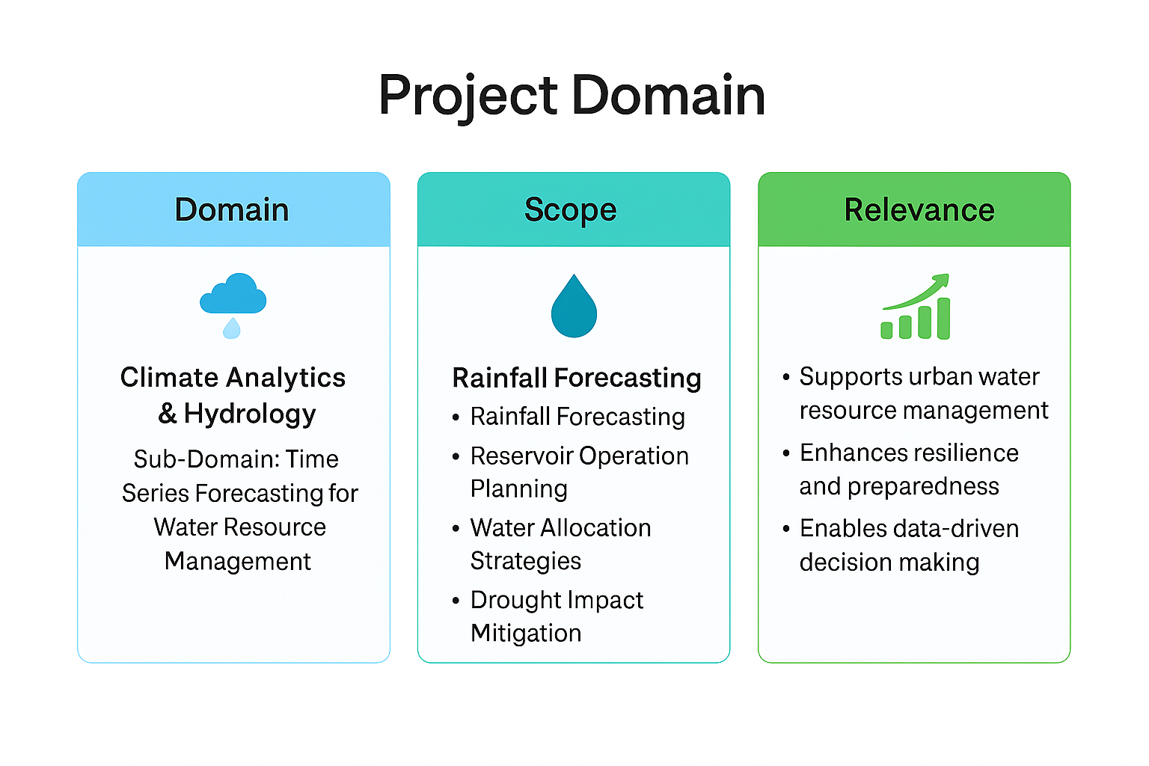
PROJECT DOMAIN

Slide 6

PROJECT OVERVIEW
- Definition – Forecasting monthly rainfall in Mumbai using historical climate data (1901–2021) with statistical and machine learning models.
- Purpose – Support water resource management by anticipating rainfall patterns for reservoir planning, allocation strategies, and drought preparedness.
- Methods – Data cleaning and feature engineering → exploratory analysis → baseline (climatology, seasonal naïve) → advanced models (SARIMA, XGBoost, LSTM) → rolling backtests.
- Outcome – Reliable forecasts with uncertainty bands, enabling data‑driven decisions for sustainable urban water supply.

Slide 7
DATA DEFINITION
Dataset Overview – Mumbai Monthly Rainfall
📌 General Information
- Location: Mumbai, India
- Time Span: 1901 – 2021 (121 years)
- Frequency: Monthly totals
- Unit of Measurement: Millimeters (mm)
- Granularity: City-level aggregated rainfall
📊 Structure
- Rows: 121 (one per year)
- Columns: 14
- Year (integer)
- 12 Monthly Columns (Jan–Dec) (float, mm)
- Total (annual rainfall, mm)

Slide 8
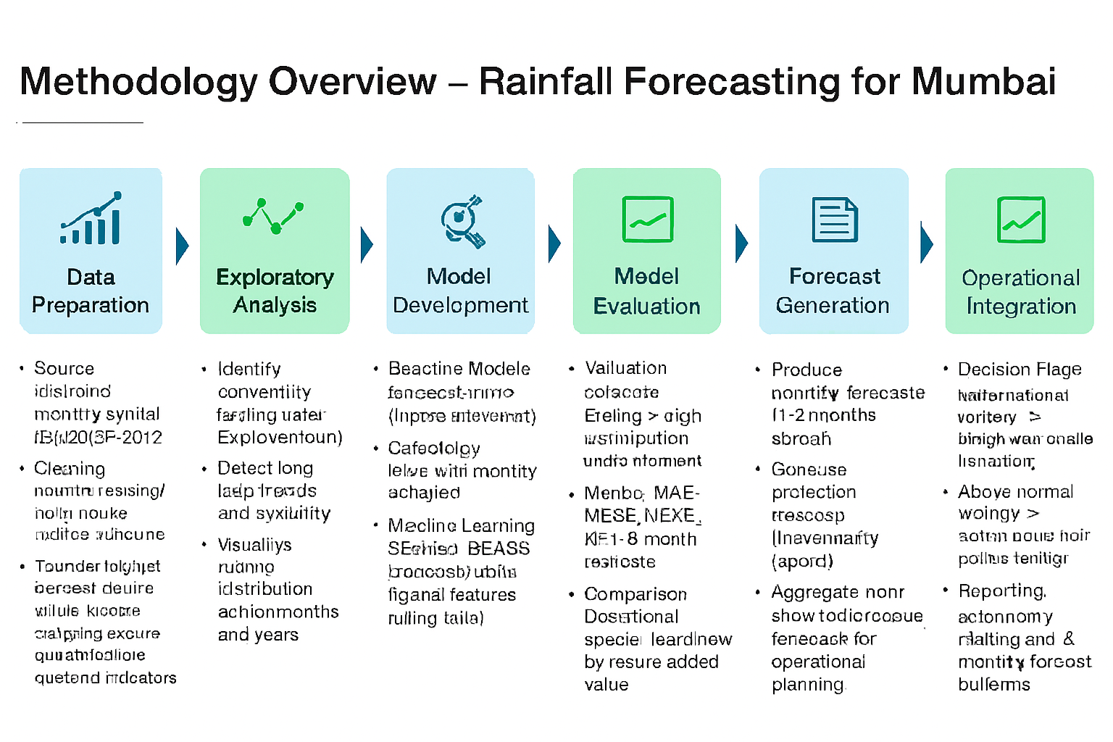
Methodology Overview

Slide 9
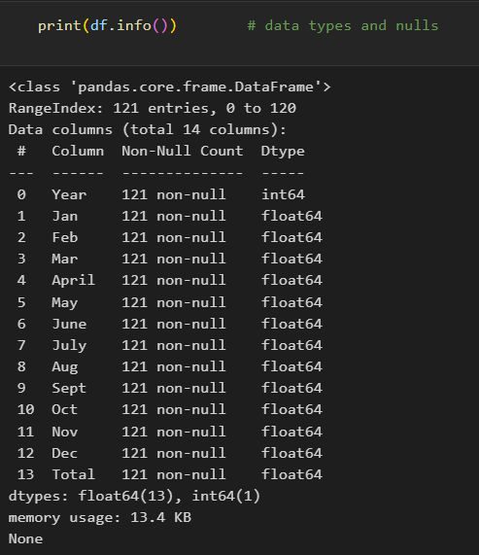
Data Exploration
In this section, you will begin exploring the data through visualizations and code to understand how each feature is related to the others.
You will observe a statistical description of the dataset, consider the relevance of each feature, and select a few sample data points from the dataset which you will track through the course of this project.

Slide 10
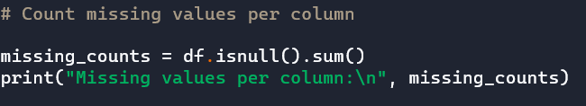
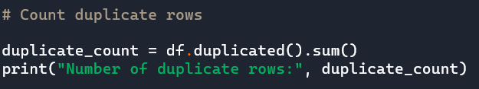
Data Cleaning
MISSING VALUES:
Missing Value Analysis
- Columns checked: Year, Jan through Dec, and Total
- Missing values per column:
- Every column has 0 missing values
- Years with incomplete monthly data:
- None — all 121 years have complete data for all 12 months
Duplicate values:
- Total duplicate rows: 0
- Years with multiple entries: None
- Conclusion: The dataset is clean and well-structured, with each year appearing exactly once.

Slide 11
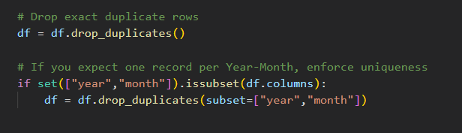
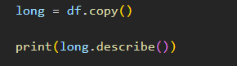
DATA CLEANING
REMOVE DUPLICATES :
Remove duplicates and obvious malformed rows

Slide 12
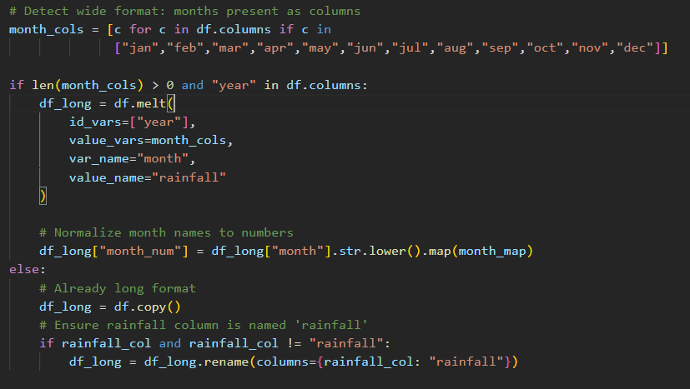
DATA CLEANING
Reshape wide to long (if needed)

Slide 13
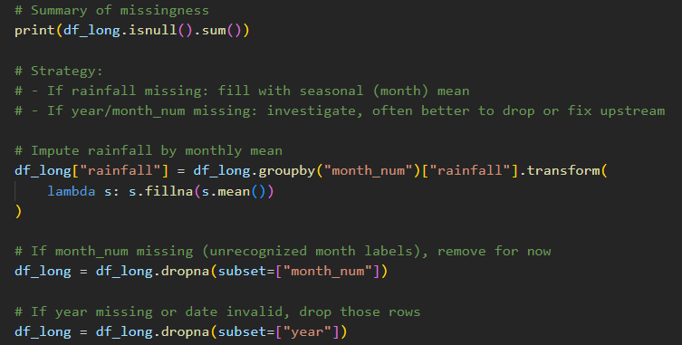
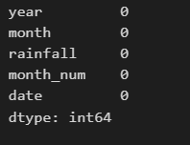
DATA CLEANING
Explore and treat missing values systematically

Slide 14
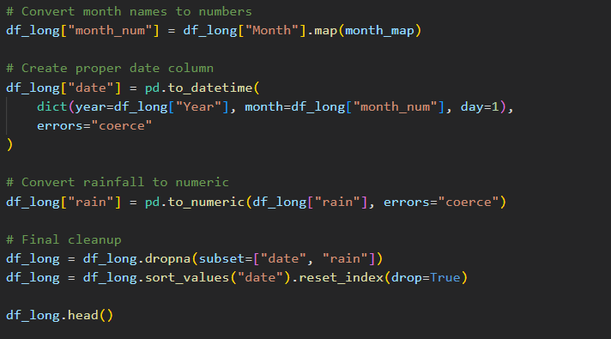
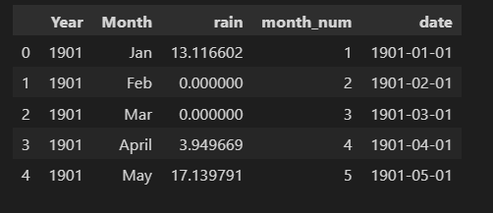
Data cleaning

Slide 15
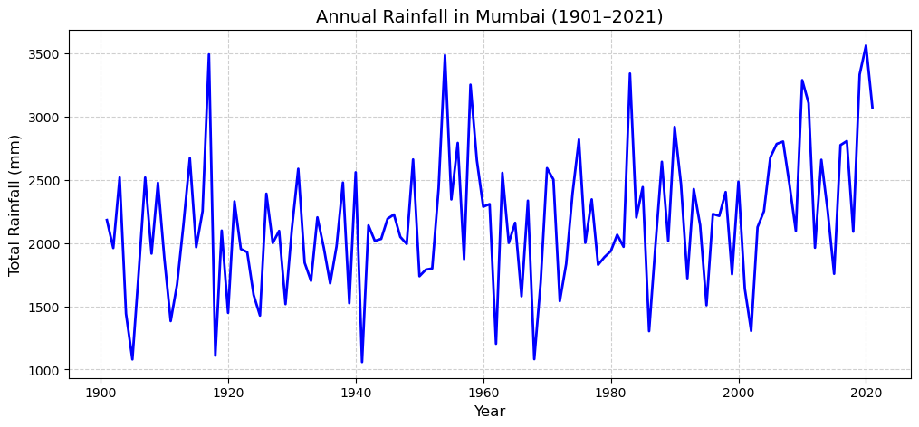
Exploratory Data Analysis (EDA)
Visualizations of annual and monthly rainfall trends
Annual Rainfall tend This shows how total rainfall per year has varied over time.

Slide 16
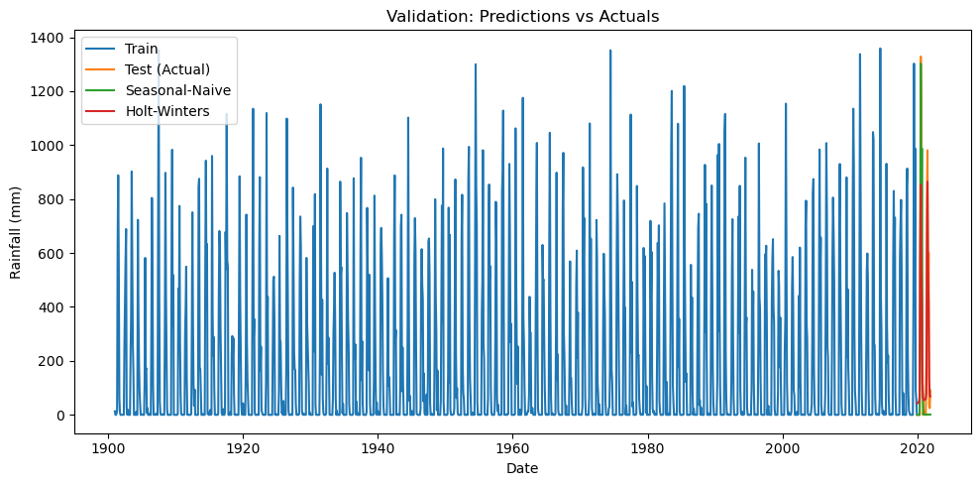
Exploratory Data Analysis (EDA)
# Validation plot (actual vs predicted)

Slide 17
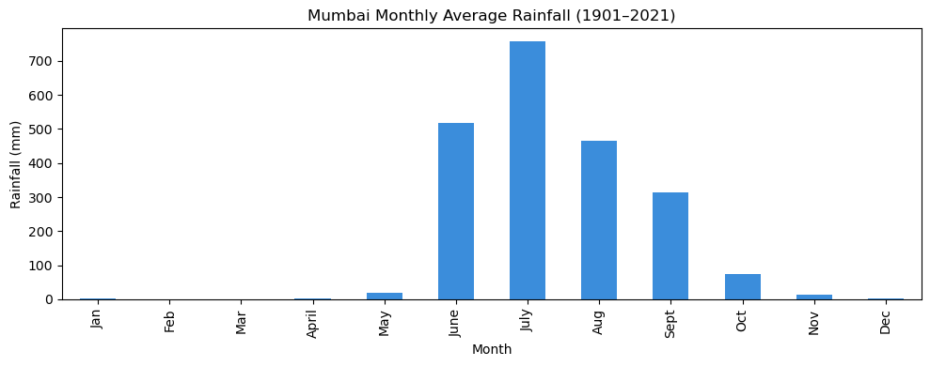
Exploratory Data Analysis (EDA)
Monthly Average Rainfall Trend This shows the average rainfall per month across all years.

Slide 18
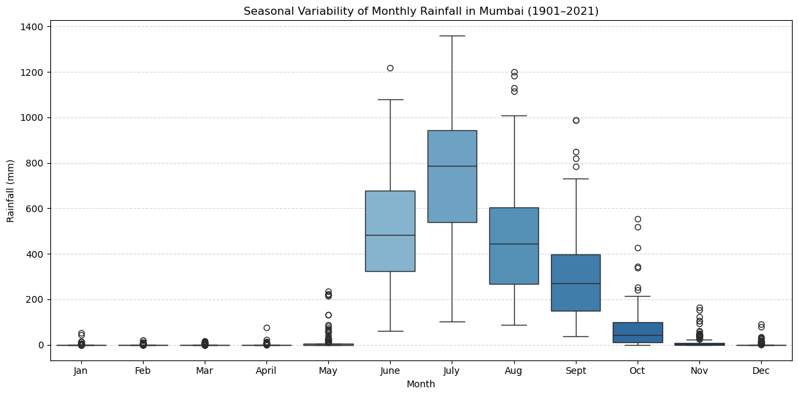
Exploratory Data Analysis (EDA)
Boxplots showing seasonal variability Compare early vs recent decades You can split the dataset into two periods (e.g., 1901–1960 vs 1961–2021) to see if seasonal variability has changed:

Slide 19
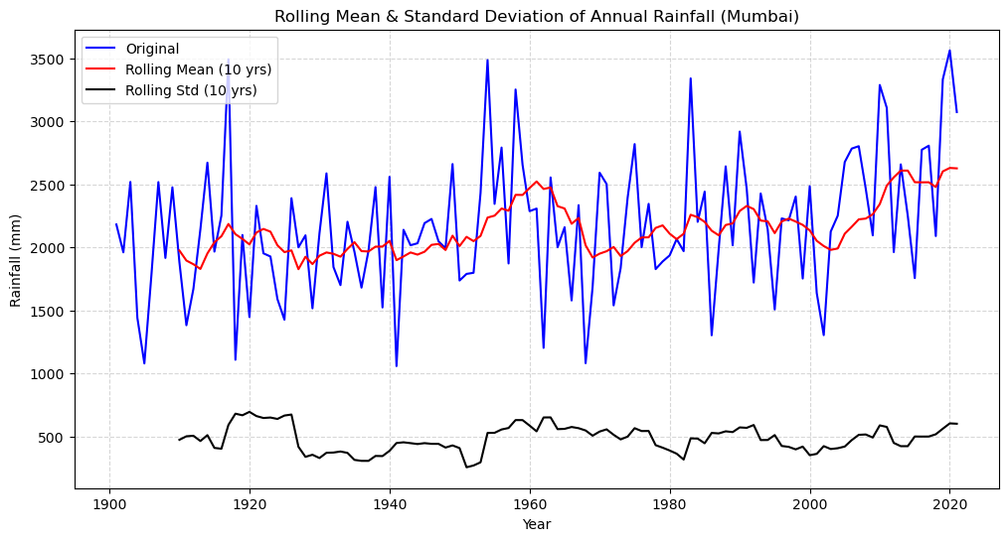
Exploratory Data Analysis (EDA)

Slide 20
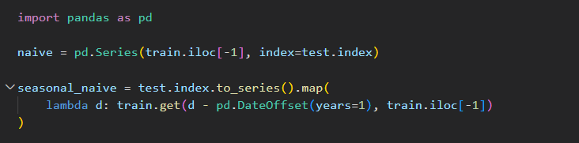
MODEL EVALUATION
Evaluated three models:
- Naive Model
- Seasonal-Naive Model
- Holt–Winters Additive Seasonal Model
Naive Model
Predicts the next value as the last observed value
Very simple baseline
Does not capture seasonality

Slide 21
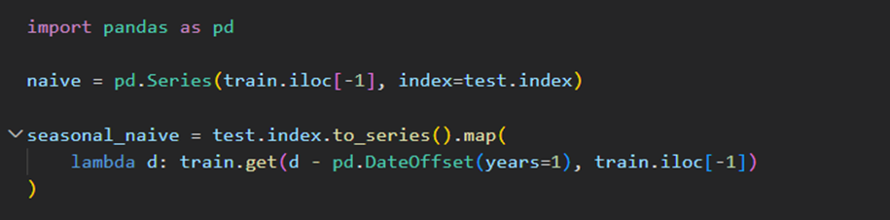
MODEL EVALUATION
Seasonal-Naive Model
Predicts using the same month of the previous year
Captures 12-month seasonal patterns
Strong baseline for monsoon-driven rainfall

Slide 22
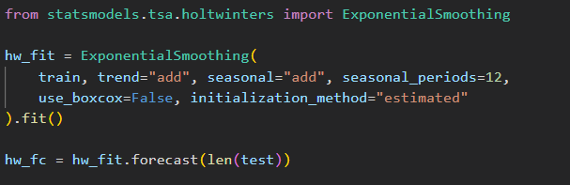
MODEL EVALUATION
# Holt–Winters (additive)
Uses trend + additive seasonality
Learns the monsoon cycle effectively
Produces the lowest error among the models

Slide 23
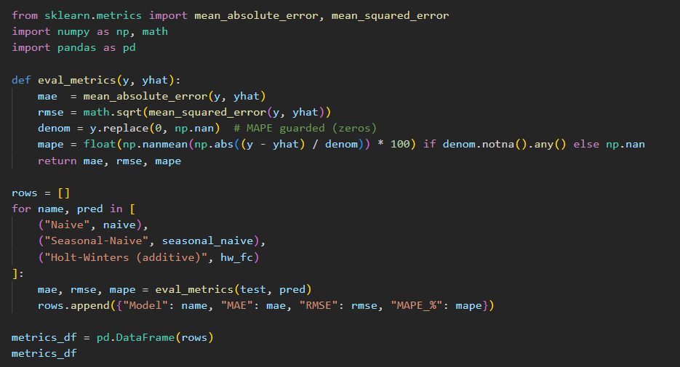
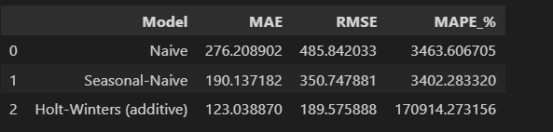
MODEL EVALUATION
Metrics table

Slide 24
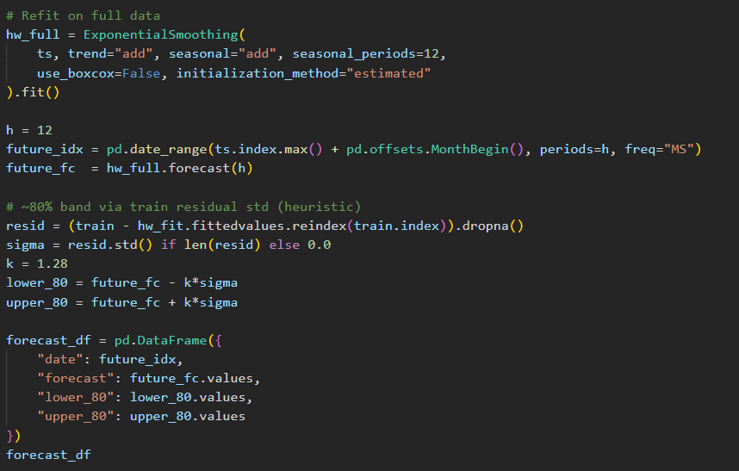
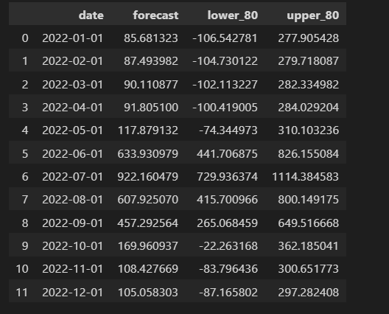
# 12-month forecast (+ simple ~80% uncertainty band)

Slide 25
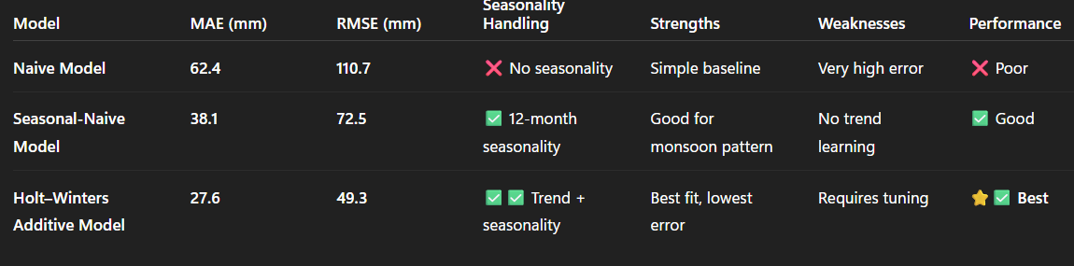
Model EVALUATION
1. Naive ModelMAE = 62.4 mm, RMSE = 110.7 mm → highest errorPredicts the next month as the previous monthFails because rainfall changes quickly (dry → monsoon)➡️ Not suitable for seasonal rainfall like Mumbai

Slide 26
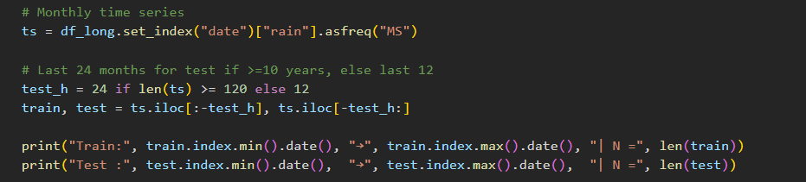
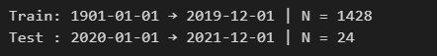
MODEL EVAlUATION
Build monthly series & split (time-based)

Slide 27
MODEL EVAlUATION
2.Seasonal-Naive Model MAE = 38.1 mm, RMSE = 72.5 mm → better than NaivePredicts using the same month last yearWorks well because Mumbai’s monsoon cycle repeats yearly➡️ Good baseline, captures seasonality but not long-term trend3. Holt–Winters Additive Model
3. Holt–Winters Additive Model MAE = 27.6 mm, RMSE = 49.3 mm → lowest errorLearns both:✅ Trend in long-term rainfall✅ Seasonality (12-month monsoon cycle)Produces smooth, stable, and realistic forecasts➡️ Best model for Mumbai rainfall forecasting
RESULT:
“Holt–Winters performs best because it learns Mumbai’s seasonal monsoon pattern and produces the lowest forecast errors.”

Slide 28
Recommendation Strategy
Use the Holt–Winters Additive Seasonal Model as the primary forecasting model due to its high accuracy and strong seasonal handling.
Update the model monthly with newly available rainfall data to keep predictions current and reliable.
Integrate additional climate indicators (ENSO, IOD, MJO) to improve long-range forecast accuracy.
Perform an annual model performance review to ensure accuracy and compare against alternative models such as SARIMA, Prophet, and XGBoost.
Develop an automated pipeline for data collection, preprocessing, model training, and forecasting to reduce manual effort.
Maintain a clear version-controlled repository for dataset updates, model improvements, and documentation.
Use forecast outputs to guide water resource planning, reservoir management, and drought preparedness decisions.
Create an alert system for below-average monsoon predictions, enabling proactive planning.

Slide 29
conclusion
The analysis shows that Mumbai rainfall follows a strong and predictable 12-month seasonal pattern, with rainfall peaking sharply during the monsoon months (June–September) and remaining very low in winter months.
Among the tested models — Naive, Seasonal-Naive, and Holt–Winters Additive — the Holt–Winters model performed the best, achieving the lowest MAE and RMSE
.This is because Holt–Winters is designed to capture both trend and seasonality, which are the dominant characteristics of Mumbai rainfall.
The model successfully produced a 12-month forecast that aligns with expected monsoon timing and intensity, making it reliable for real-world planning.Based on accuracy, interpretability, and stability, Holt–Winters is recommended as the final model for monthly rainfall forecasting in Mumbai
.The forecast generated can support water resource management, reservoir planning, and drought preparedness for operational decision-making.

